Slide 1
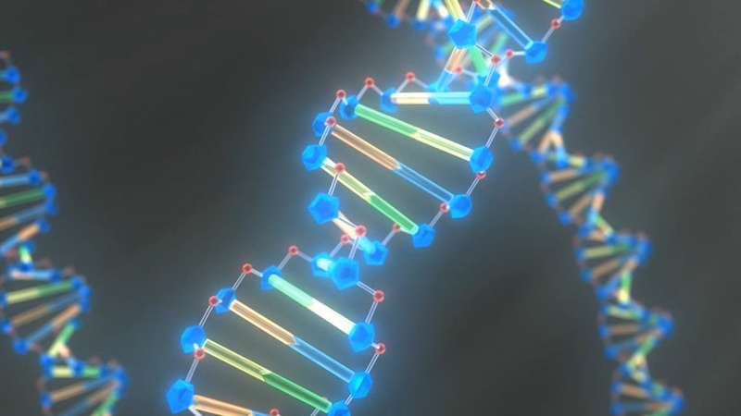

Introduction to Jupyterlab in Google Collab
Gildas Hounmanou, PhD
APTI-Fellow, National Institutes of Health, MD, USA
Assistant-Professor
https://orcid.org/0000-0003-3991-0864
University of Copenhagen
Faculty of Health and Medical Sciences
Section for Food Safety and Zoonoses
Department of Veterinary and Animal Sciences

Slide 2
Instructions
Before you start working on the notebook, do the following:
Open the link https://drive.google.com/drive/folders/1QjkMvsA1r6Yr_BNsF5H8PPUDfPchpEET?usp=sharing
Go to File > Save a copy in Drive to save the notebook to your own Google Drive.
Now You can edit and run the notebook independently, and your changes will only affect your copy.
Follow step by step instructions for analysis

Slide 3

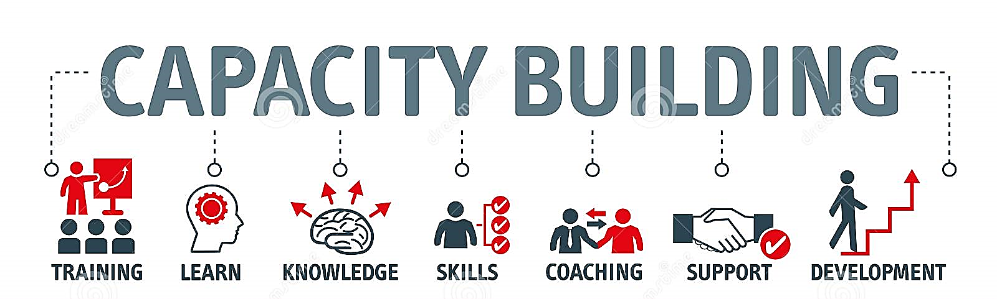
Gildas Hounmanou, PhD
APTI-Fellow, National Institutes of Health, MD, USA
Assistant-Professor
https://orcid.org/0000-0003-3991-0864
University of Copenhagen
Faculty of Health and Medical Sciences
Section for Food Safety and Zoonoses
Department of Veterinary and Animal Sciences

